Slide 1
Daniel Nderitu
Phase 1 project submission
A Cross-film analysis

Slide 2
Business Problem
Microsoft sees all the big companies creating original video content and they want to get in on the fun. They have decided to create a new movie studio, but they don’t know anything about creating movies. You are charged with exploring what types of films are currently doing the best at the box office. You must then translate those findings into actionable insights that the head of Microsoft's new movie studio can use to help decide what type of films to create.

Slide 3
SOLUTION
Based on the problem above, an analysis is done to select the best films Microsoft should make/produce that’ll make the most box office sales.
This will be based on 3 detailed datasets carefully analysed to identify optimal traits that make for good film sales
Lastly, we’ll settle on the most optimal traits based on the impact each has on the sales of the films.

Slide 4
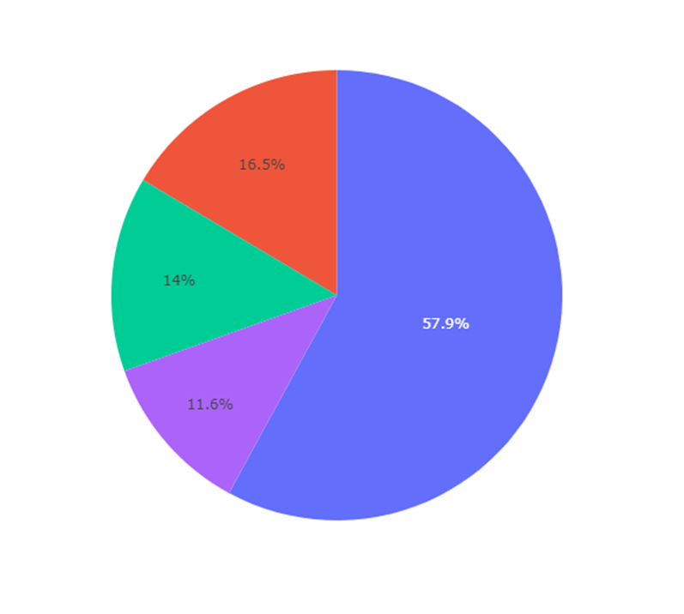
PIE CHART REPRESENTATION OF THE RATING RATIOS;
R – 57.9%
PG-13 – 16.5%
PG - 14%
NR – 11.6%
The most common movie rating is the R rated movies with 57.9%

Slide 5
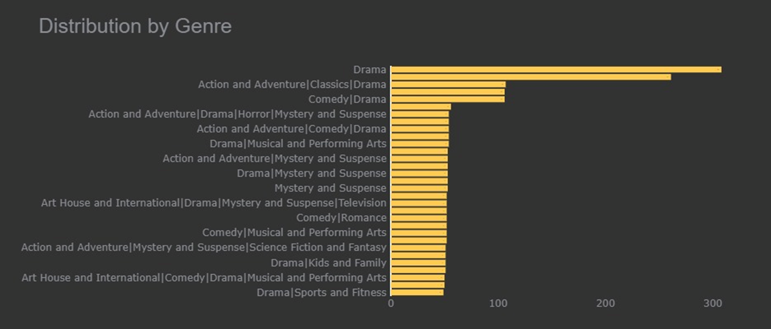
Popularity by Genres;
You’ll notice as seen below that the most popular genre involves Drama:

Slide 6
Based on the above summaries what are our recommendations:
1. Impact of Directors on Box Office Sales
2. Impact of Genre on Box Office Sales
3.Impact of release date (Month) on Box Office sale

Slide 7
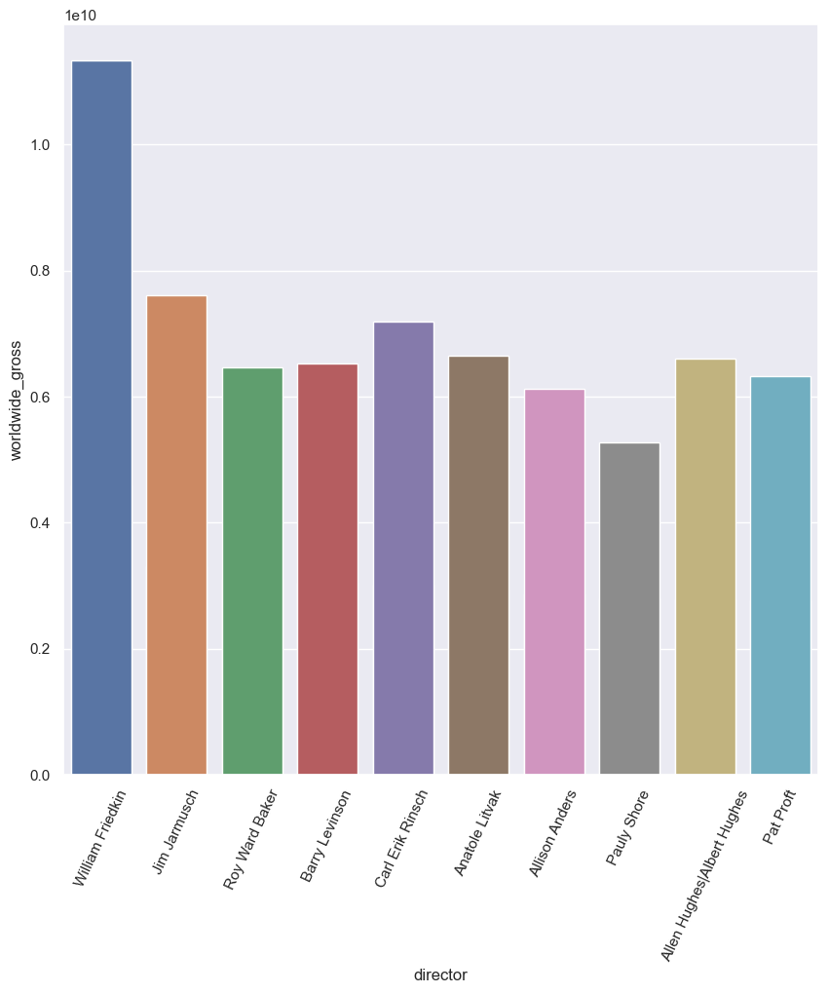
1. Impact of Directors on Box Office Sales
From the findings we examine the impact different directors have on the success of the movie.

Slide 8
As seen above; some Directors make for really good business.
And in the above graph we’ve highlighted the top ten of them with William Friedkin taking a significant lead.

Slide 9
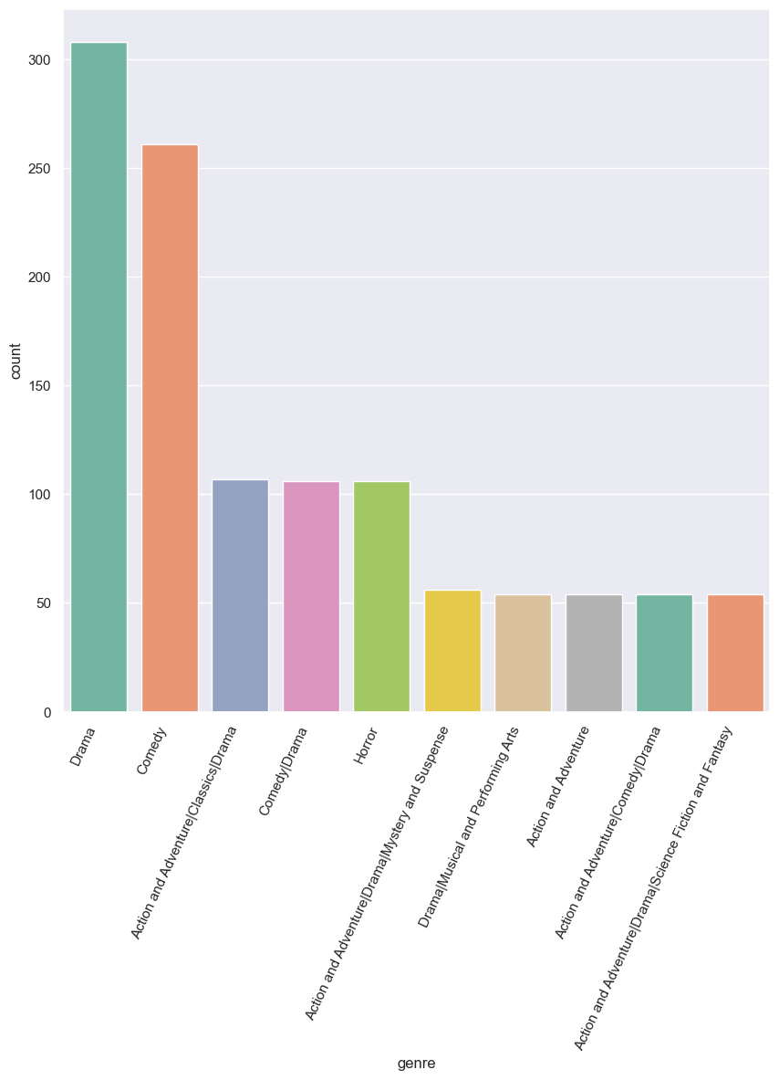
Impact of genre on Box Office Sales

Slide 10
After careful examination of the Data. We’ve come to the conclusion and therefore recommend that further emphasis is placed on the genre of our preferred Film.
The highest ranking films according to the genre metric is Drama. And it very often recurs in other popular films as well.

Slide 11
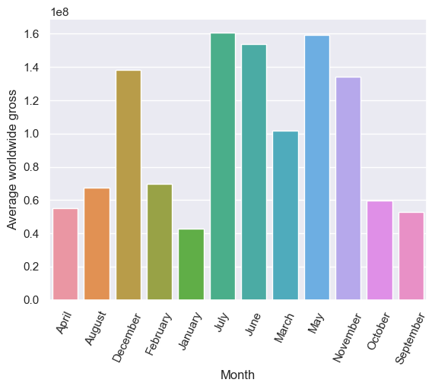
Impact of release date(month) on Box Office Sales

Slide 12
After careful analysis we’ve settled on months that’ll will be ideal to release our films and that will be May, June Or July since they’ve consistently shown over time to have better box office sales compared to the rest of them.

